Slide 1

Housing Price Prediction - 2020

Slide 2
BAN 612_01 GROUP 3
Akhila Bolisetty (vbolisetty@horizon.csueastbay.edu)
Haripriya Kumar (hkumar9@horizon.csueastbay.edu)
Nivedhitha Kumarasamy (nkumarasamy@horizon.csueastbay.edu)
Prakash Chokkalingam (pchokkalingam@horizon.csueastbay.edu)
Surya Thangaraj (sthangaraj@horizon.csueastbay.edu)
Utkarsh Upadhyay (uupadhyay3@horizon.csueastbay.edu)

Slide 3
Agenda:
Objective
Bay Area Housing Trends
Research Questions
Data Visualization
Models &
Project Summary
Conclusion
Technical Aspects

Slide 4
Bay Area Housing Market Prices & Trends – A GLIMPSE
According to U.S Census Bureau, the median home price in
1980 - $148,000
2000 - $180,000
2010 - $375,000
2020 - $1,500,000
Bay Area Real Estate – most expensive market in California
The average value of a home in the city is more than one-million dollars more than the median home value in the United States.

Slide 5
How the COVID has affected the Bay Area real estate market
Record Unemployment & Volatile Stock market
Uncertain economic times during COVID has affected the buyer’s & seller’s mindset
- Buyer’s reluctant to invest during recession
- Seller’s removed the house listing and the number of newly listed properties declined
- Real Estate market frozen as soon as the pandemic started
But..
Due to the deadliest pandemic people now see their home not only as a place to live, but as a shelter and workspace.

Slide 6
FACTORS THAT INFLUENCE THE BUYING PATTERN
Location
Price
SQFT
Number of bedrooms & bathrooms
Single Occupancy or Family houses
Parking space
Neighbourhood
Proximity to shop & essentials
Public transport facilities

Slide 7



Dataset & Attributes
Zillow - https://www.zillow.com/homes/
Web Scraping using Python
Attributes Scraped – ZPID, Address, City, ZipCode, Home Listing price, Zillow Zestimate, sold_year number of bedrooms, number of bathrooms, House type, House size, House built year, parking, house lot sqft, HOA, Price per sqft, walk score and description, transit score and description

Slide 8
Research Questions.
City with highest number of listings by ratio
Trend of Price over the years
Housing Prices – by city in Bay Area
Which type of house are selling faster than other
City vs Walk score
How good is city transport system
Price per sqft of the house listings on zillow
Built year distribution of the house on Zillow
House types listed across multiple cities
Zestimate compared to the Actual listed price
Number of Bedrooms houses sold – by city

Slide 9

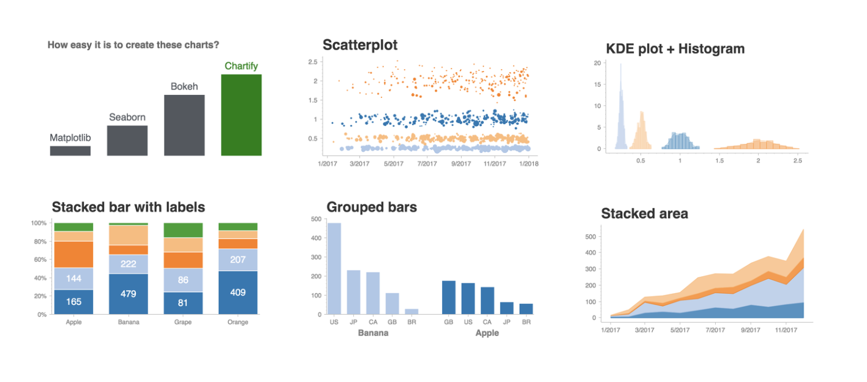

Why Data Visualization is Needed?

Slide 10
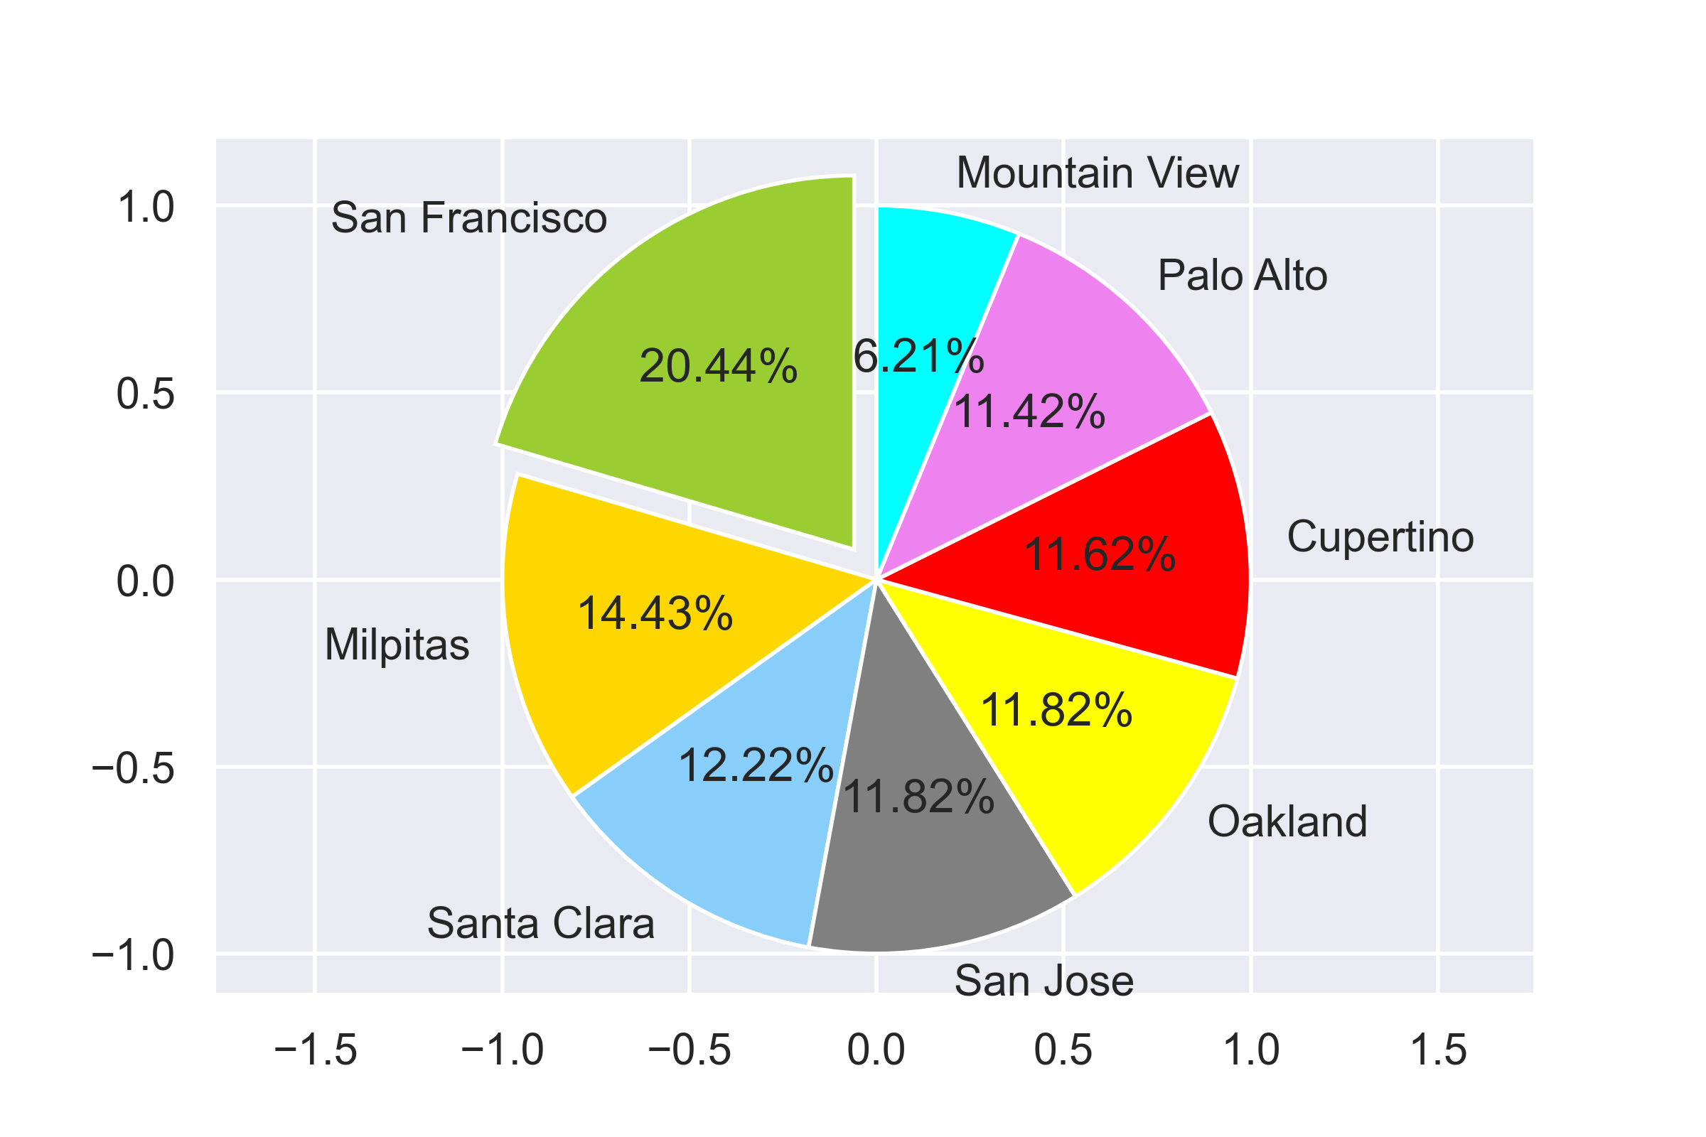
City with highest number of listings by ratio
We can see that the San Francisco has the highest number of Active listings.
Mountain View has the lowest number of active listings

Slide 11
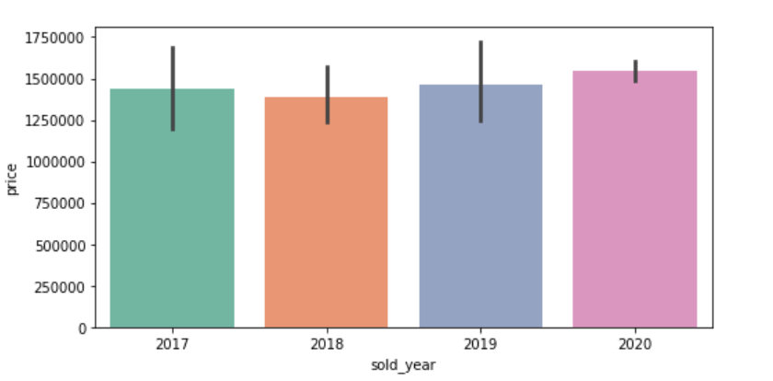
Trend of Price for the different years
Looking at the bar graph we get to know that there is a trend of price increasing every year and it can be seen the prices have only increased in 2020 too.

Slide 12
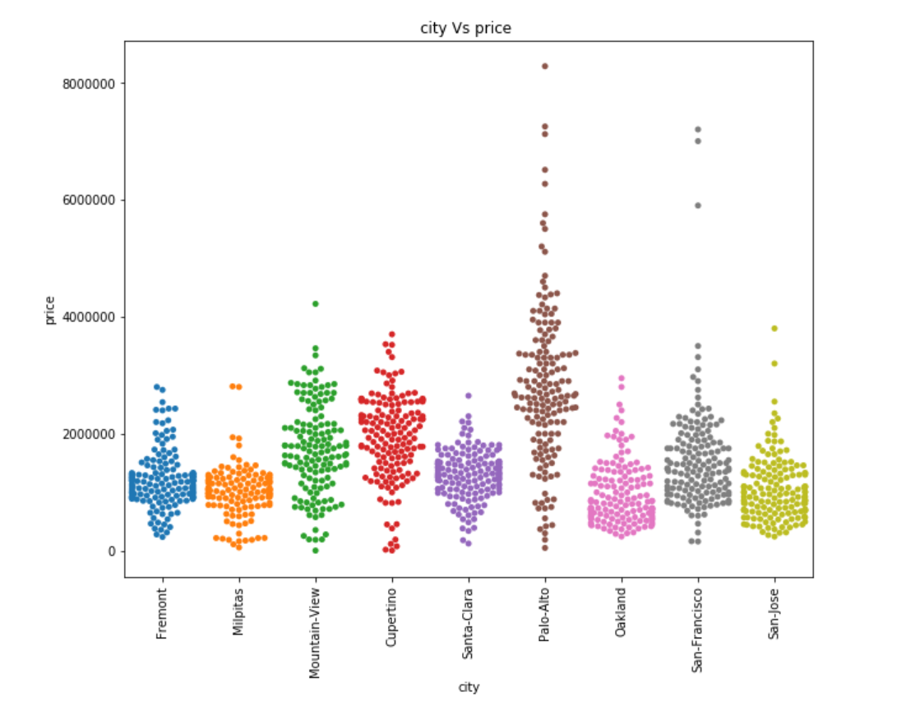
Housing Prices – by city in Bay Area
Palo Alto shows a wide range of prices for the houses sold.
High Prices – Mountain-View, Palo-Alto, San-Francisco
Medium Prices – Fremont, Milpitas, Santa-Clara, Oakland

Slide 13
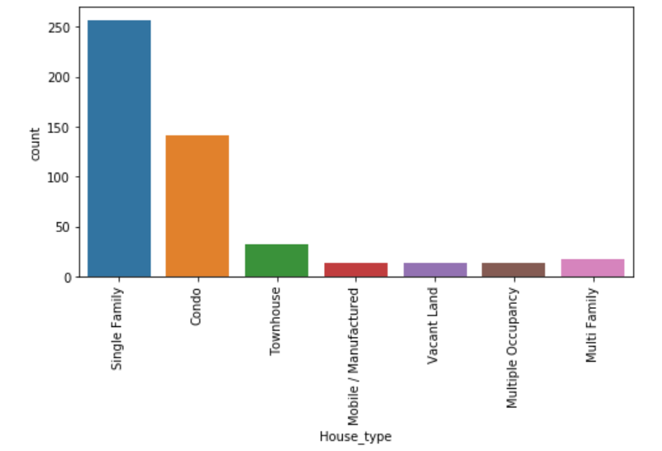
Which type of house are selling faster than other?
Single Family houses are the ones sold more

Slide 14
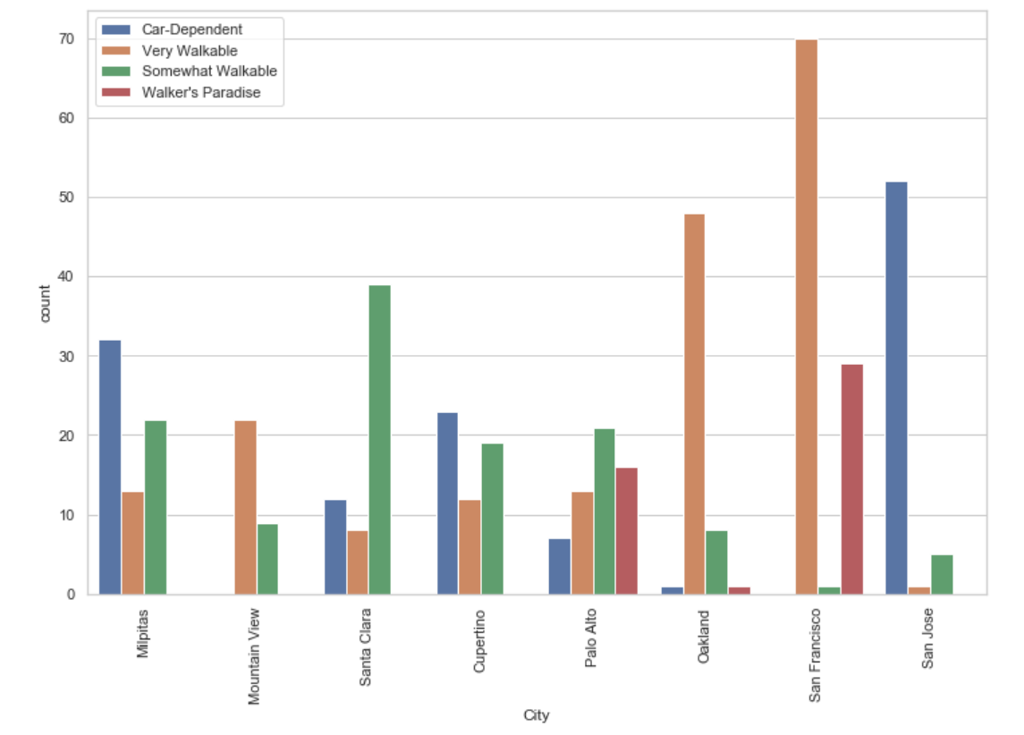
City vs Walk score
The number of houses sold in San Francisco is more which has all the essentials at a very walkable distance
San Jose and Milpitas is mostly car-dependent cities

Slide 15
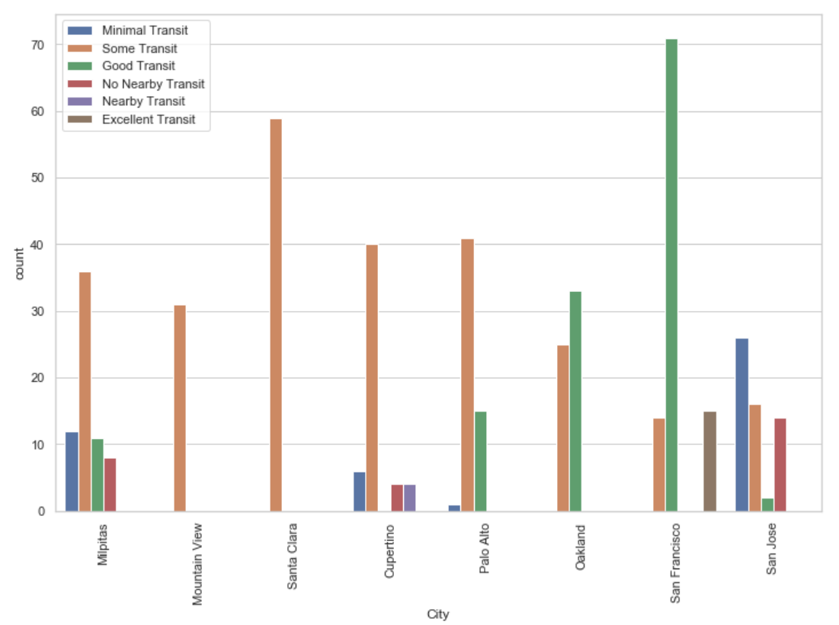
How good is city transport system
San Francisco has good transit options and hence the number of houses sold is more
Santa Clara & Mountain View has only some transit options.

Slide 16
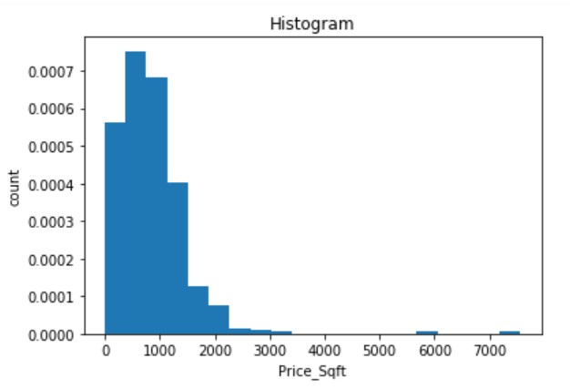
Price per sqft of the house listings on zillow
Listings belonging to 500 to 1500 price sqft are predominantly listed.

Slide 17
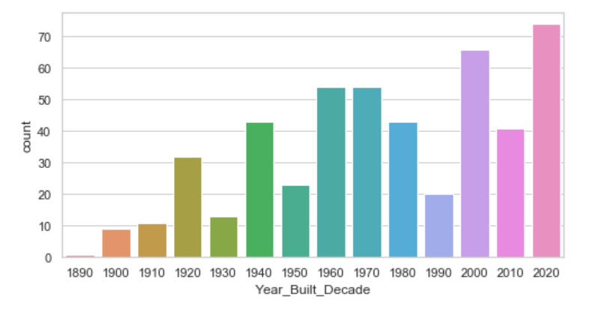
Built year distribution of the house on Zillow
Majority of the houses listed currently belongs to freshly built homes.
With respect to old houses, houses built in 2000’s are on sale on larger volume.

Slide 18
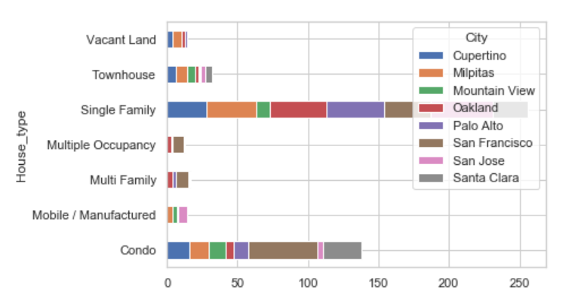
House types listed across multiple cities
Multiple occupancy type homes are least common across cities
Single Family homes are most commonly listed in Oakland and Condos are listed in high numbers in San Francisco

Slide 19
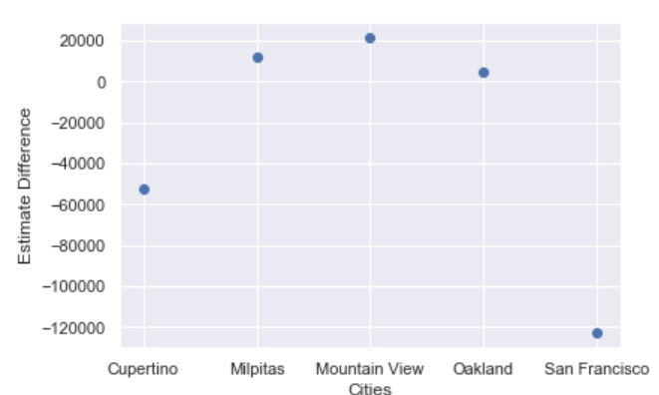
Zestimate compared to the Actual listed price
Oakland and Milpitas seem to have Zestimate closest to the actual listed price.
San Francisco’s Zestimate is very low compared to the actual listed price.

Slide 20
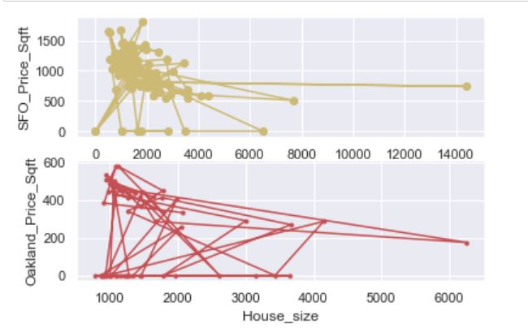
Price per square feet of the Houses in San Francisco and Oakland
San Francisco has the higher rate of per SQFT for the houses when compared to Oakland.

Slide 21
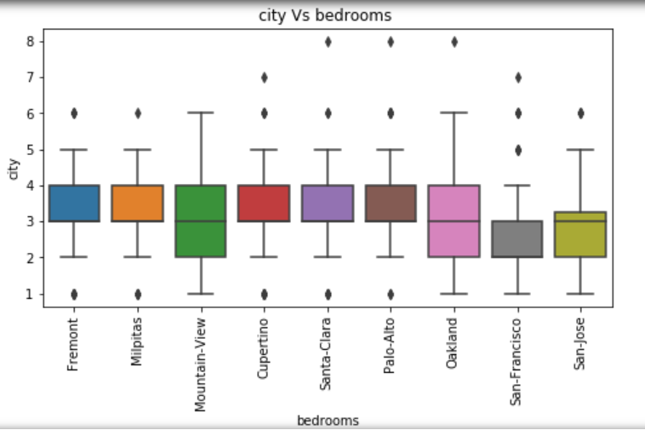
Number of Bedrooms houses sold – by city
Shows the distribution of number of bedroom houses sold by city.
The outliers in this are the number of bedrooms which are more than 5.

Slide 22
Develop a Modeling Framework - to estimate the price of the house
Linear Regression
Linear regression models assume that the relationship between a dependent continuous variable Y and one or more explanatory (independent) variables X is linear (that is, a straight line).
Predicts values within a continuous range (e.g. sales, price) rather than trying to classify them into categories (e.g. cat, dog).
Linear regression models can be divided into two main types: Simple & Multiple
Random Forest Regressor
Supervised learning algorithm used for Classification & Regression.

Slide 23
Predictors & Outcome Variable
predictors = ['Bed',
'Bath', 'House_size', 'Year_Built', 'Parking', 'Lot',
'HOA', 'Price_Sqft', 'walk_score', 'transit_score’]
outcome = 'List_price'

Slide 24
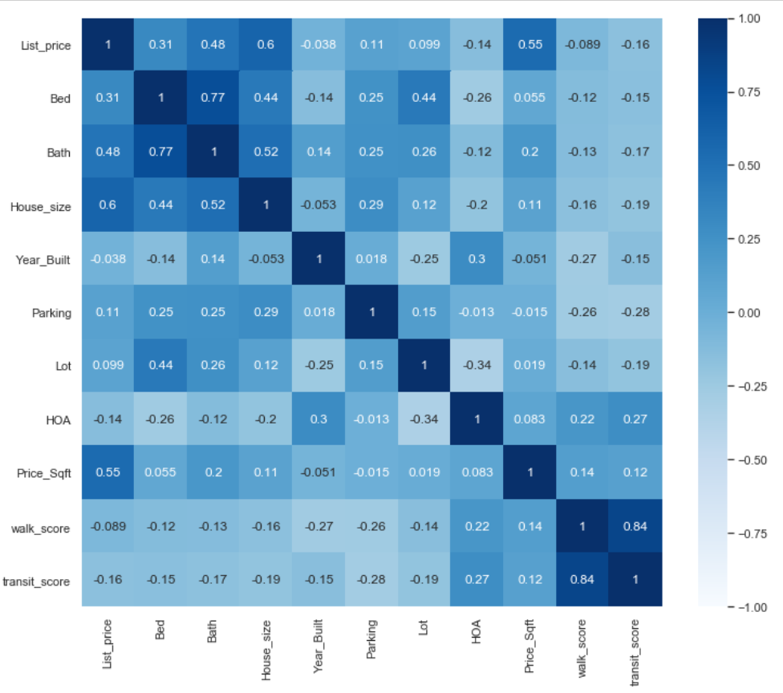
Correlation Analysis

Slide 25
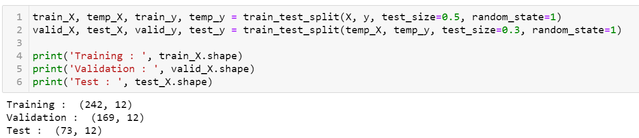
Training, Validation & Test Dataset

Slide 26
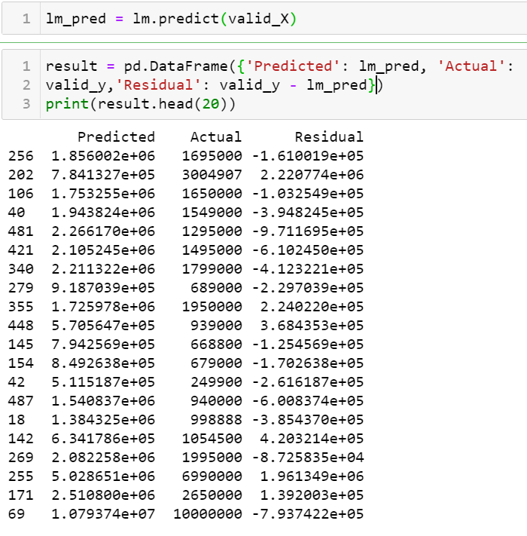
Predicted Housing Prices -Linear Regression
Actual List Price = $1,695,000
Zestimate = $1,721,954
Predicted Price = $1,856,000

Slide 27
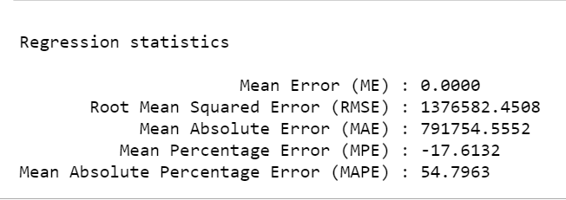
Regression Statistics – Linear Regression

Slide 28
Random Forest Regressor
Supervised Learning algorithm used for classification & regression tasks with the use of multiple decision trees and a technique called Bootstrap Aggregation, commonly known as bagging
The basic idea behind this is to combine multiple decision trees in determining the final output rather than relying on individual decision trees.

Slide 29
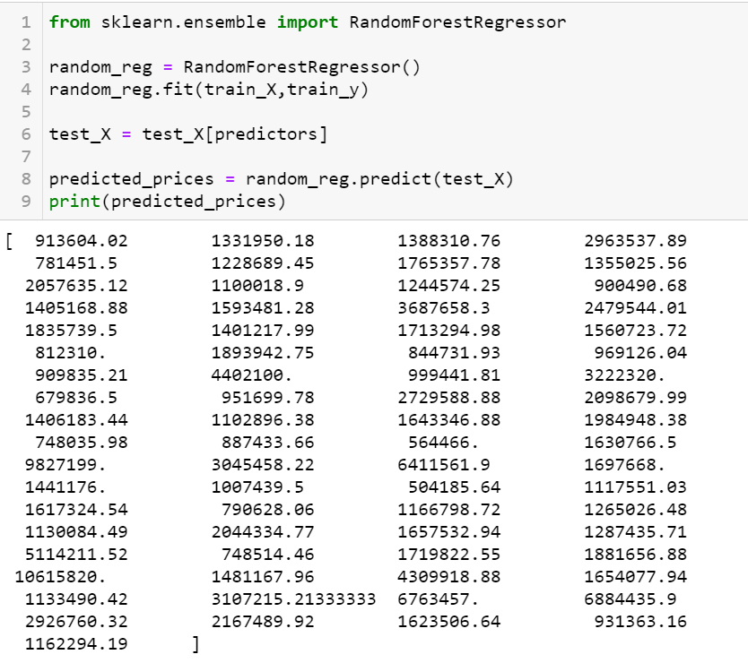
Random Forest Regressor
Comparison between the actual & predicted prices
List price = $1,299,000
Zestimate = $1,451,613
Predicted price using Random Forest Regressor = $1,331,950

Slide 30
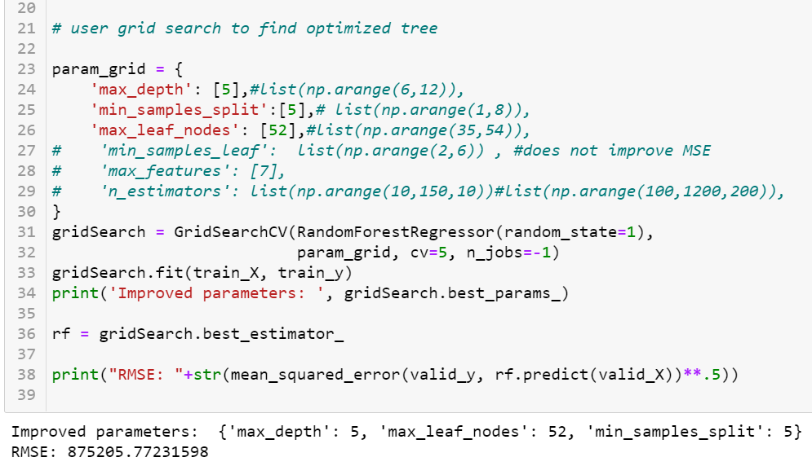
Grid Search to find Optimized tree

Slide 31
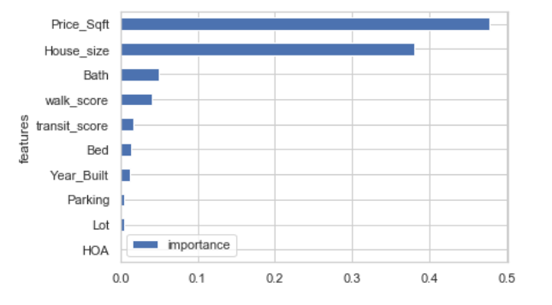
Variable Importance

Slide 32
Comparison of RMSE between Linear Regression & Random Forest
RMSE is less for Random Forest Regressor and hence, we propose Random Forest for predicting the housing prices.
Linear Regression | Random Forest Regressor
Root Mean Squared Error (RMSE) : 1098555.7883 | Root Mean Squared Error (RMSE): 875205.77231598

Slide 33

Is 2020 a good year to buy house?

Slide 34
Conclusion
The housing prices have dropped and again increased in 2020. More number of houses are sold in the Bay area even during the pandemic.
Single Occupancy houses does not have a considerable increase in price.
San Francisco remains a hot spot for buying houses in Bay Area.
San Francisco has excellent transit options and walk score which shows that the neighborhood is good. Hence the number of houses sold in SFO is more.
House Buyers preferences are based on the zipcode, price per sqft and house size. These attributes have higher significance when they are choosing the house.

Slide 35


Slide 36
Technical Aspects of the Project

Slide 37
Web scraping is a technique for targeted, automated extraction of information from websites.
It extracts the data from the web, and turning unstructured data on the web (including HTML formats) into structured data that you can store to your local computer or a database.
Its much more efficient, faster and less error-prone to automate the task when compared to manual extraction of data.

Slide 38
Web sites contain detailed and frequently updated information that may be useful to official statistics.
We can enrich the results of the traditional methods with automatically collected information.
Web data may enable new types of indicators that are not feasible with traditional methods.
The collection and analysis time is much faster than performing these tasks manually.

Slide 39
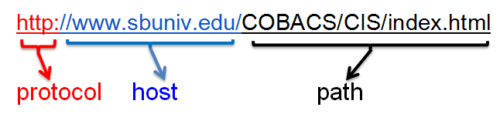

Machine interchange information transported over the Internet to enable multi-media data exchange. The protocol defines aspects of authentication, requests, status codes, persistent connections, client/server request/response. etc.
The server is made connected with the v=client with the help of Python libraries.
The web page is opened and stored in a file.
The file is read and stored in string format
The webpage is parsed using Beautiful Soup.
The information is extracted using soup, findAll,
attributes.

Slide 40
Libraries & packages
Beautiful Soup : Python library for pulling data out of HTML and XML files
urllib : Python library that collects several modules for working with URLs
urllib.request : Module for opening and reading URLSs
urllib.parse : Module for parsing URLs
urllib.urlopen : Module for opening URLs
json : Python library to transmit data in web applications.

Slide 41
Our dataset comes from Zillow website.
The dataset contains house listing prices and its parameters for houses which are listed on the website.
There are about 500 observations in the dataset which are scraped.
There are about 18 total attributes in the dataset.

Slide 42
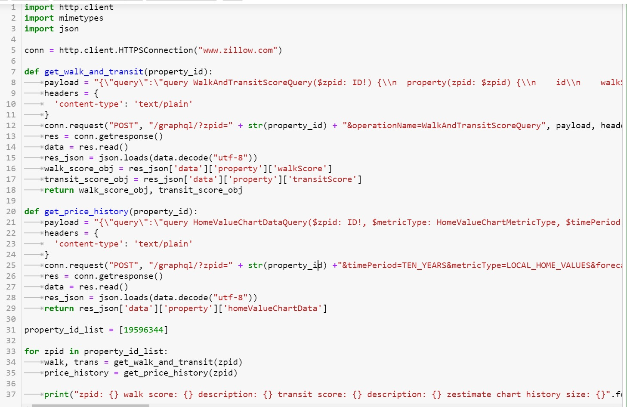
Walk and Transit score – Function for data scraping.

Slide 43
Attributes
Variables : Definition
ZPID : unique ID of each house
Address : location
City : city
ZipCode : postal code
List_price : listing price on zillow
Zestimate : price estimated by zillow
sold_year : year sold
Bed : no. of bedrooms
Bath : no. of bathrooms
House_type : type of house
Variables : Definition
House_size : size of house ( sq ft)
Year_built : house built year
Parking : no. of spaces
Lot : size of lot (sq ft)
HOA : fees ($)
Price_sqft : price per sq ft ($)
walk score : walkability of any address using a patented system.
transit score : measure of any address by public transit (1-100)

Slide 44
Data Preprocessing

Slide 45
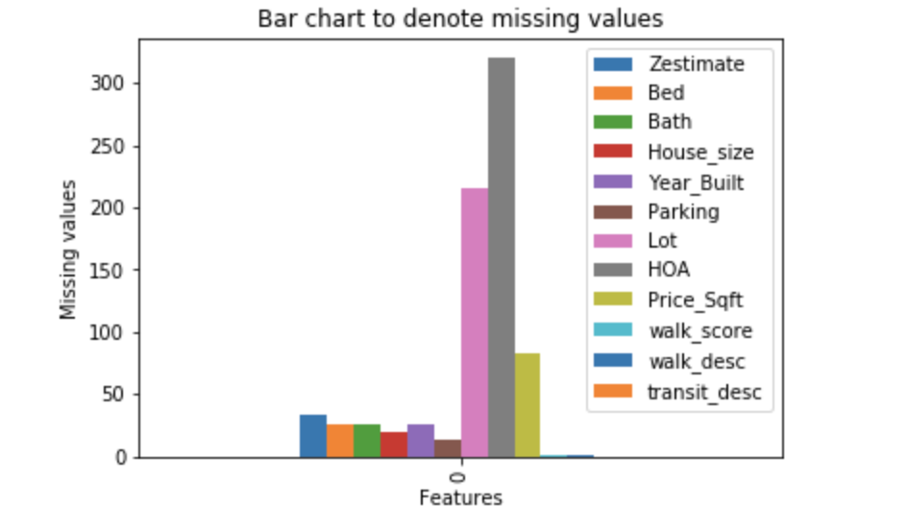
Data Cleaning and Preparation
Handling missing Data:
43.2 % of parking Lot is missing
64% of HOA is missing

Slide 46
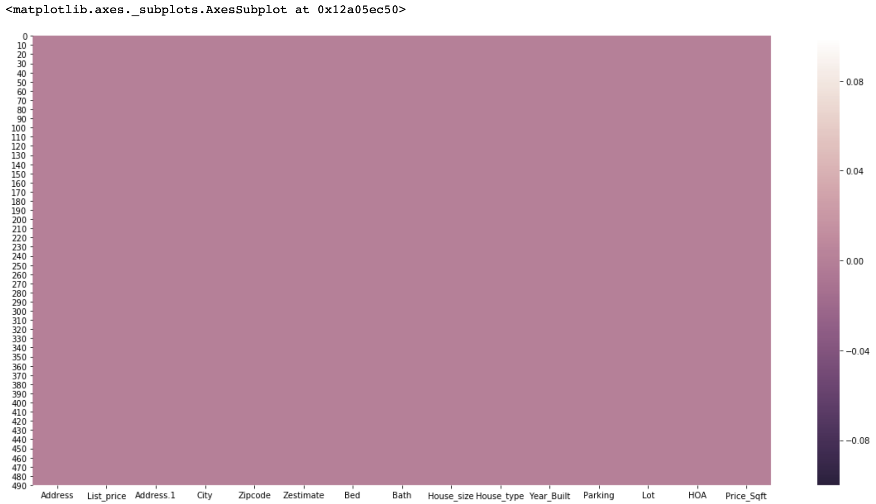
Heatmap after treating missing values:

Slide 47
Removing special characters
“sqft”
“acres"
“$"
“/“,"month","mo","/month","/mo"
Imputing Values
Zestimate
Year built

Slide 48
Thank you ! Questions ?...

